Slide 1
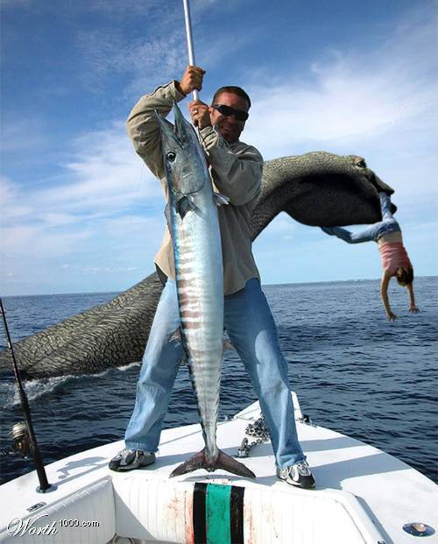
Thats legit

Slide 2
Hoaxes
What is a hoax?
One of the most famous hoaxes ever - the loch ness monster
Hoaxes generate lots of money/profit

Slide 3
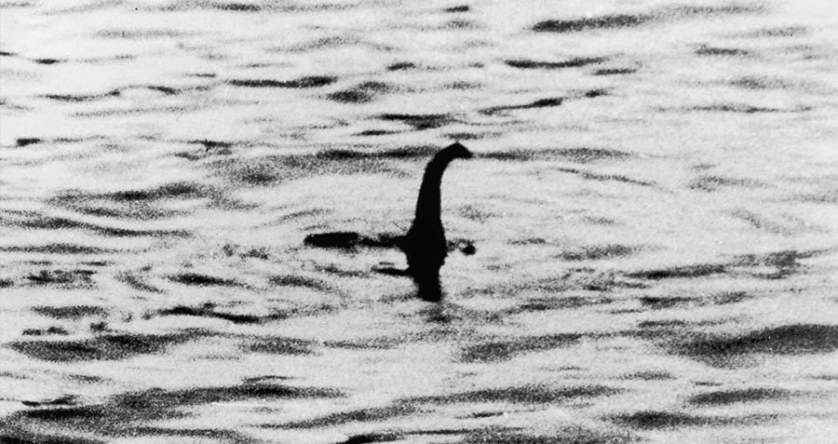

Slide 4


Slide 5
Myths
UNICORNS ARE REAL!

Slide 6
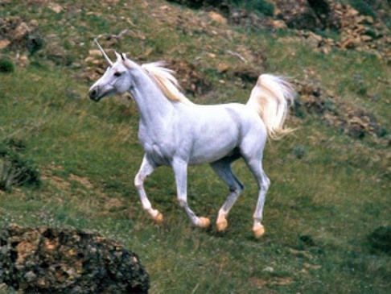

Slide 7
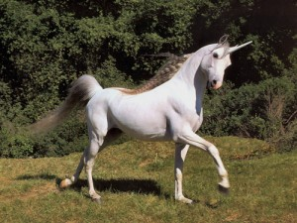
AND THIS?

Slide 8
Myths : unicorns
Not everyone knows unicorns are a myth, some people ACTUALLY believe they exist o.O

Slide 9
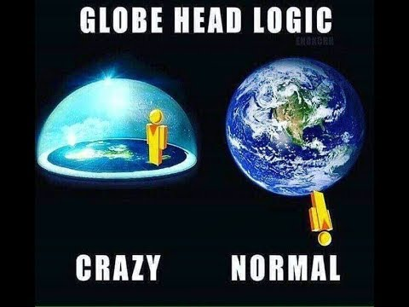
Just like... flat earthers

Slide 10
Theories
There are many kinds of theories e.g:
# Game theories - story and stuff,
# Scientific Theories - just like Einstein's relativity paper
# Theories about unexplained stories (mysteries) - Like Bermuda's triangle
Theories try to tell what could've happened but its not certain though

Slide 11
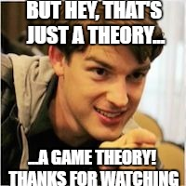
I didn't find any cool picture about theories so...

Slide 12
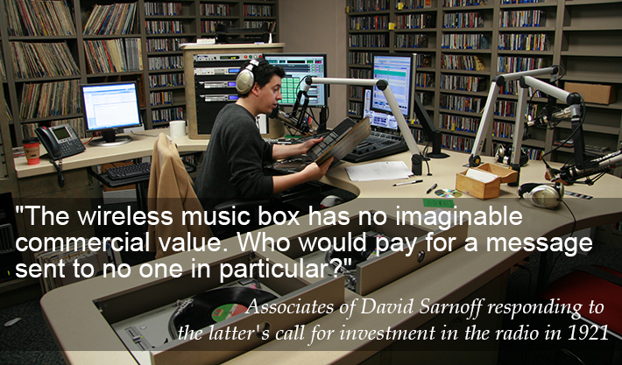

Slide 13
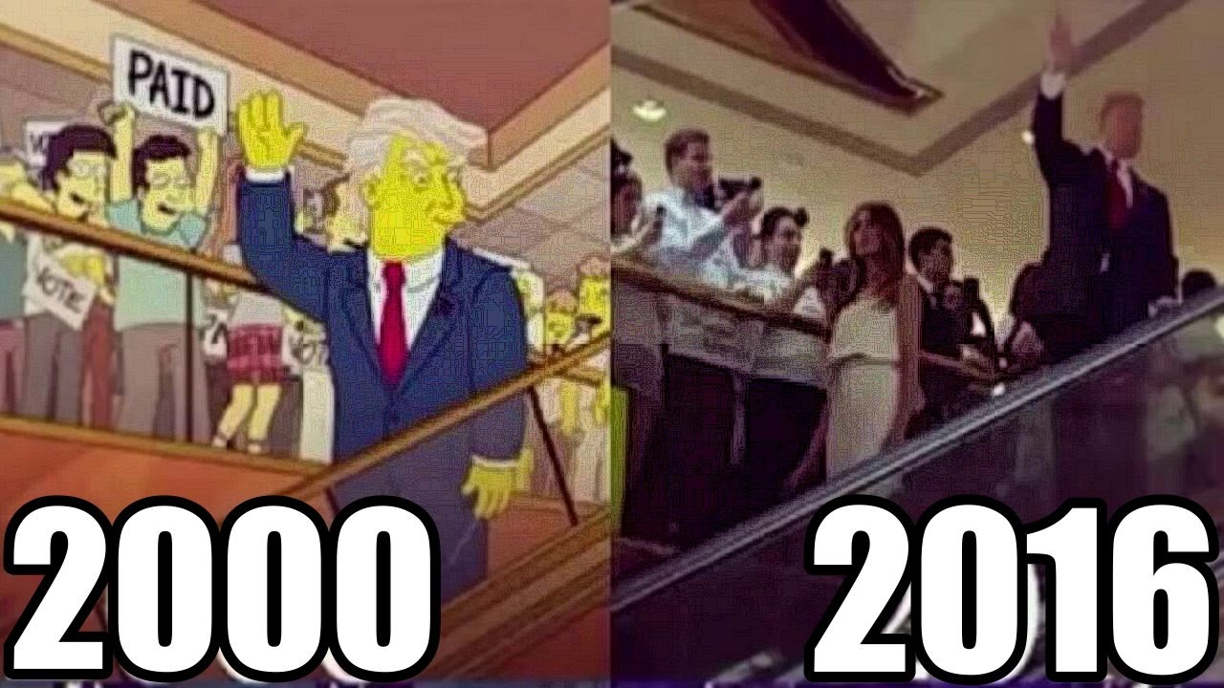

Slide 14
Predictions
The Simpsons is kind of crazy with their 'predictions'
There are some kinds of predictions too! e.g:
# Accurate predictions (not a real term though) - e.g: Math, Physics, Chemistry etc.. which tries to predict events and things about other things using math and ACTUAL logic to find reasonable results
# Foolish predictions (also not a real term) - e.g: People trying to predict the future. idk how do people not realize that humans are not THAT good at predicting the future...
# Everyday predictions (also... not a real term) - e.g: 'so, i am going on a trip next week, so i will plan stuff out. i am planning on going to Minnesota, so it will be VERY COLD probably, so i am going to bring more clothing.', basically PLANNING
I predict that this slide is over.

Slide 15
I WAS RIGHT!

Slide 16
or was i?

Slide 17
Mysteries
I hadn't heard about the 'moai' statues mystery till' last month or so, i thought it was very interesting!
This is one of the most famous mysteries that i found on the internet, literally one of the first results in google image search for "famous mysteries"
So many theories talking about how they moved these statues, HOW DID THEY MOVE THESE GIANT A$$ Statues? Was it magic?

Slide 18
WAS IT ALIENS?

